Slide 1
Business Dashboard Summary
A comprehensive view of key metrics and trends

Slide 2
Title
Business Dashboard Summary is a concise overview of key performance indicators.
It serves as a visual representation of data for quick insights.
The title sets the tone for the presentation and engages the audience.

Slide 3
Purpose
The purpose of this presentation is to inform stakeholders about business performance.
It aims to highlight important metrics that drive decision-making.
By summarizing data, the dashboard allows for effective communication of trends and insights.

Slide 4
Key Metrics
Key metrics include sales growth, customer acquisition, and operational efficiency.
These metrics help in assessing the overall health of the business.
Regular tracking of these indicators enables timely strategic adjustments.

Slide 5
Visual Representation
Visual elements, such as charts and graphs, enhance data comprehension.
They allow for quick identification of patterns and anomalies.
A well-designed dashboard makes complex data accessible and actionable.

Slide 6
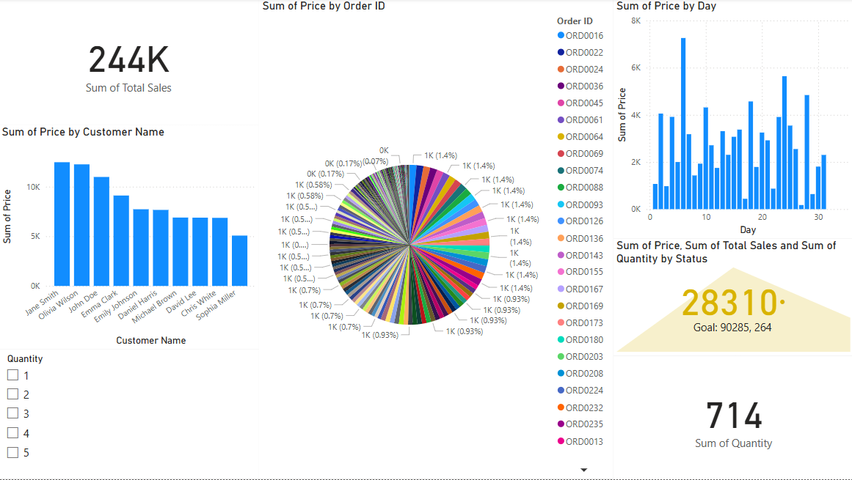
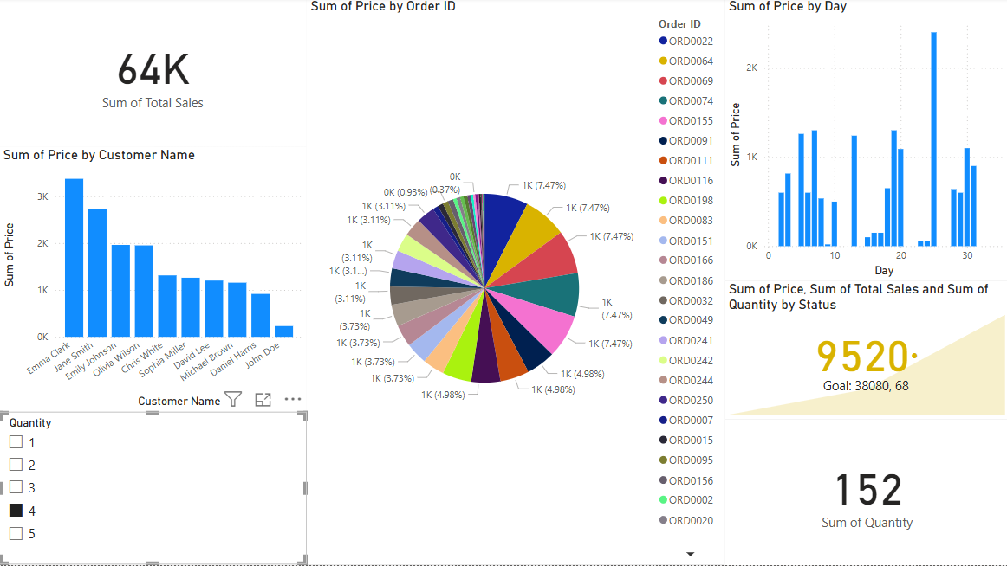
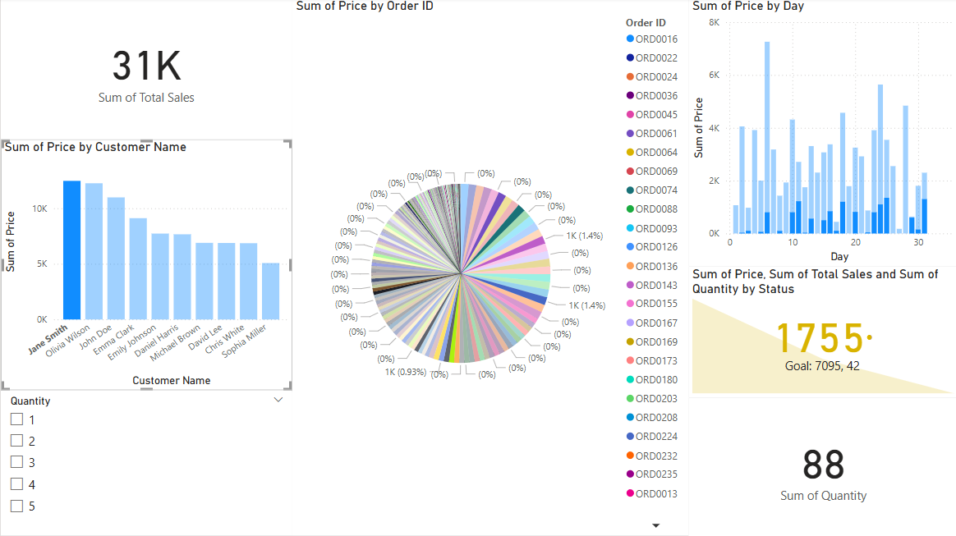
Screenshots of Dashboard

Slide 7
Benefits of Dashboard
Dashboards provide real-time access to critical business information.
They facilitate proactive decision-making by highlighting areas of concern.
Utilizing dashboards can lead to improved performance and accountability across teams.

Slide 8
Conclusion
In conclusion, the Business Dashboard Summary is an essential tool for stakeholders.
It consolidates important data into a digestible format for easy analysis.
An effective dashboard can significantly enhance business strategy and execution.

Slide 9
THANK YOU

